Slide 1
Data set Exploration
Autonomous systems AS-733
MovieLens-10M
Sample data Experiment
Re-run setting sample=(2 ,4, 8) respectively
Average the weights to combine the models

Slide 2
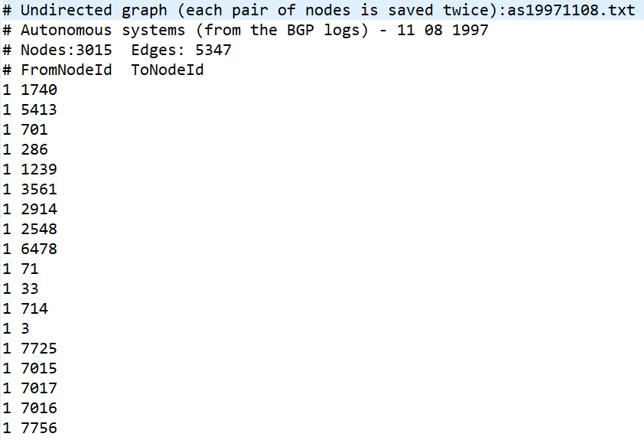
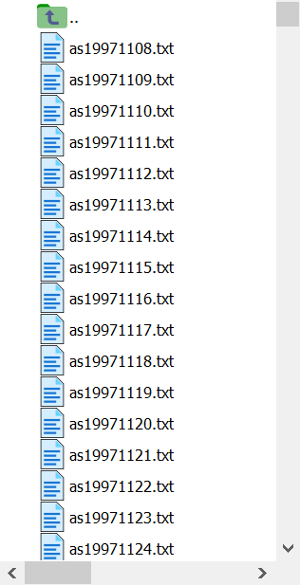
Autonomous systems AS-733
SNAP: Network datasets: Autonomous systems - AS-733 (stanford.edu)
http://snap.stanford.edu/data/as-733.html
Autonomous systems graph (Leskovec et al. (2005)) is a communication network from the Border Gateway Protocol logs. The graph has 733 daily snapshots from Nov 1997 to Jan 2000. The graph grows from 103 to 6,474 nodes and from 243 to 13,233 edges.
Dataset | Users | Items | Interactions
AS-733 | 4078 | 500 | 2282501

Slide 3
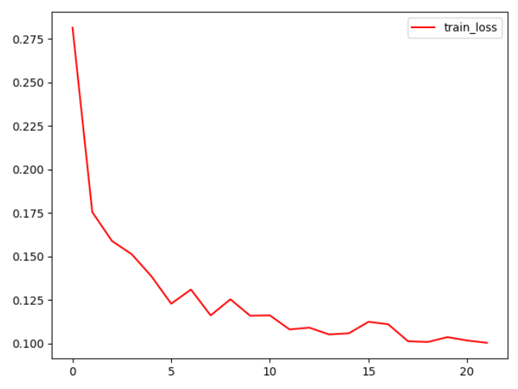
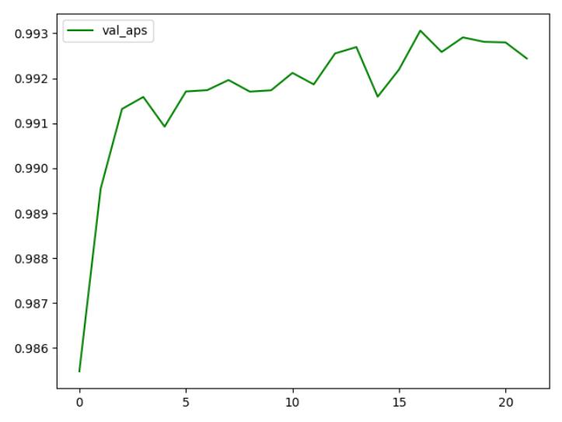
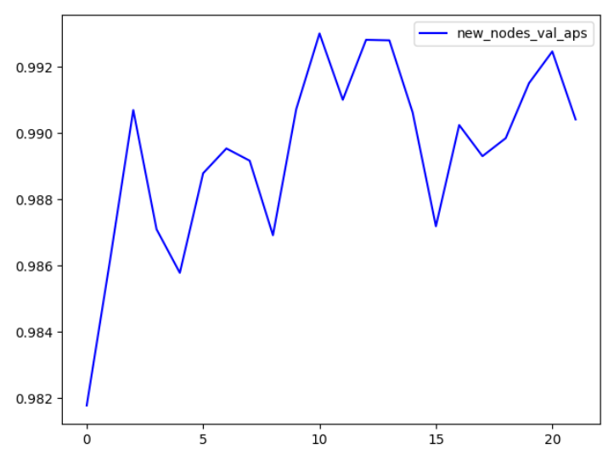
Autonomous systems AS-733
SNAP: Network datasets: Autonomous systems - AS-733 (stanford.edu)
http://snap.stanford.edu/data/as-733.html
Dataset | Test AP (Transductive) | Test AP (Inductive)
AS-733 | 0.9913 | 0.9829

Slide 4
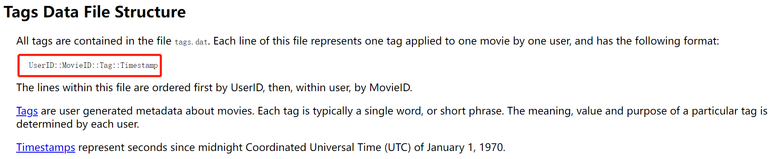
MovieLens-10M
MovieLens 10M Dataset | GroupLens
https://grouplens.org/datasets/movielens/10m/
The MovieLens dataset (Harper and Konstan (2016)) is a dynamic user-tag interactions dataset. It consists of 10 million ratings and 100,000 tag applications applied to 10,000 movies by 72,000 users. The dataset shows the tagging behavior of users on the movies they rated.
Dataset | Users | Items | Interactions
MovieLens-10M | 71567 | 10681 | 95580

Slide 5
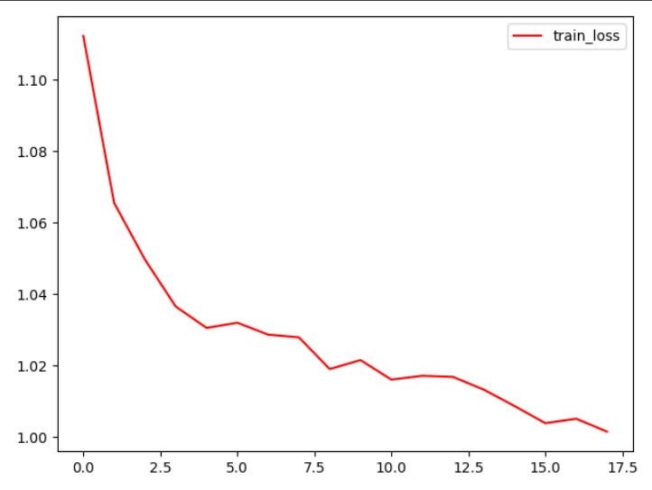
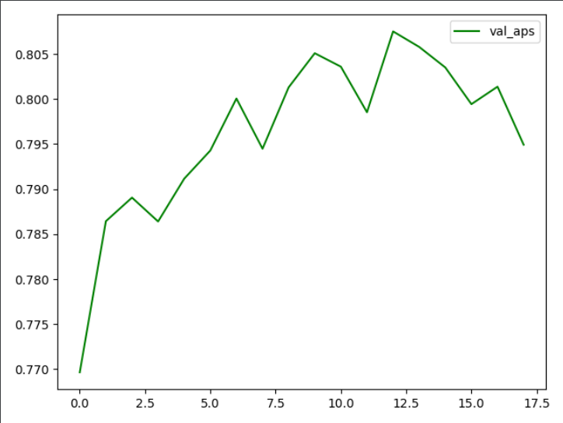
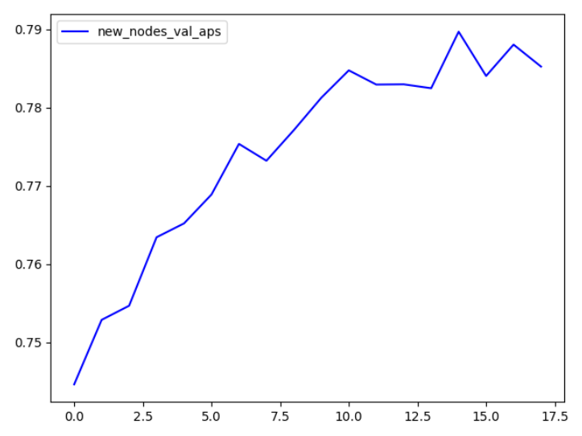
MovieLens-10M
MovieLens 10M Dataset | GroupLens
https://grouplens.org/datasets/movielens/10m/
Dataset | Test AP (Transductive) | Test AP (Inductive)
MovieLens-10M | 0.8108 | 0.7419

Slide 6
Sample | Test AP (Transductive) | Test AP (Inductive)
2(0) | 0.9816 | 0.9753
2(1) | 0.9821 | 0.9753
2(average) | 0.6025 | 0.6703
4(0) | 0.9750 | 0.9687
4(1) | 0.9712 | 0.9646
4(2) | 0.9742 | 0.9676
4(3) | 0.9748 | 0.9696
4(average) | 0.9609 | 0.9596
8(0) | 0.9622 | 0.9546
8(1) | 0.9607 | 0.9552
8(2) | 0.9598 | 0.9568
8(3) | 0.9613 | 0.9554
8(4) | 0.9598 | 0.9508
8(5) | 0.9637 | 0.9532
8(6) | 0.9626 | 0.9587
8(7) | 0.9635 | 0.9579
8(average) | 0.9545 | 0.9533

